Slide 1
Optimizing Revenue with Ticket Pricing and Facilities Investments
Data-driven recommendations for executives
Q4 2020

Slide 2
Problem identification - Context and Success Criteria
What is the optimal ticket pricing strategy that will allow Big Mountain Resort to increase their ticket prices such that this year's revenue also increases by at least $1.5M?
Success Criteria:
The new ticket pricing must increase this year’s revenue by at least $1.5M, to offset the upcoming increase annual operating from the new chairlift.
The new ticket prices must be higher than the previous year’s prices.
The ticket pricing strategy, and any other changes, must be supported by sound data science.

Slide 3
Problem identification - Scope
In-Scope:
Primary: Ticket pricing strategy.
Secondary: Data-supported cost reductions that do not reduce the ticket price, and data-supported expenditures that will justify setting a higher ticket price.

Slide 4
Recommendation and key findings
Ticket Prices:
As soon as practicable, temporarily increase the ticket price at least to $83.83, and, after any necessary preparations, increase the ticket price a second time to between $83.83 to $104.60.
Facilities Investments:
Close one run to reduce costs without reduction in revenue.
Add a run to increase the resort’s vertical drop by 150 feet with no additional snow making coverage, and install a new chair lift to increase revenue by $3.47M annually.

Slide 5
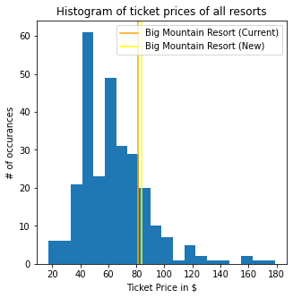
Modeling results and analysis - Ticket Price
Based on the data from comparable ski resorts in America, the geography and existing facilities investments at Big Mountain Resort justify a minimum ticket price between of $83.83

Slide 6
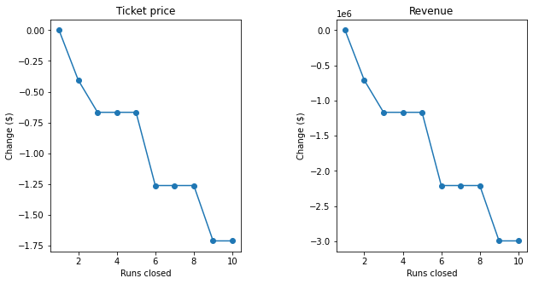
Modeling results and analysis - Facilities Investments
One good investment:
Scenario 1: Permanently closing down up to 10 of the least used runs:
In general, closing more than 1 run will require a decrease in ticket price with each incremental closure. There are exceptions where closing additional runs will not marginally decrease the support for ticket price

Slide 7
Modeling results and analysis - Facilities Investments
One possibly good investment, under the right conditions:
Scenario 2: Add a run to increase the resort’s vertical drop by 150 feet with no additional snow making coverage, and install a new chair lift.
Increase in revenue is $3.47M annually, but there are still other unknown factors to consider, before this can be called a good investment.

Slide 8
Modeling results and analysis - Facilities Investments
Two bad investments:
Scenario 3: Add 2 acres of snow making capacity to scenario 2
Scenario 4: Increase the longest run by 0.2 mile, add snow making coverage of 4 acres
Both investments would result in now change in ticket price.

Slide 9
Summary and conclusion
Recommendation #1: increase ticket price (currently $81) to at least $83.83 and up to $104.60.
Recommendation #2: Closing one run now, as this closure will not affect the ticket price.

